Slide 1

Module 3: Locking and Concurrency
Locking Concepts and Mechanics
Isolation Levels
Transactions
Blocking and Deadlocks

Slide 2
Conditions and Terms of Use
This training package is proprietary and confidential, and is intended only for uses described in the training materials. Content and software is provided to you under a Non-Disclosure Agreement and cannot be distributed. Copying or disclosing all or any portion of the content and/or software included in such packages is strictly prohibited.
The contents of this package are for informational and training purposes only and are provided "as is" without warranty of any kind, whether express or implied, including but not limited to the implied warranties of merchantability, fitness for a particular purpose, and non-infringement.
Training package content, including URLs and other Internet Web site references, is subject to change without notice. Because Microsoft must respond to changing market conditions, the content should not be interpreted to be a commitment on the part of Microsoft, and Microsoft cannot guarantee the accuracy of any information presented after the date of publication. Unless otherwise noted, the companies, organizations, products, domain names, e-mail addresses, logos, people, places, and events depicted herein are fictitious, and no association with any real company, organization, product, domain name, e-mail address, logo, person, place, or event is intended or should be inferred.
Copyright and Trademarks
© 2011 Microsoft Corporation. All rights reserved.
Microsoft may have patents, patent applications, trademarks, copyrights, or other intellectual property rights covering subject matter in this document. Except as expressly provided in written license agreement from Microsoft, the furnishing of this document does not give you any license to these patents, trademarks, copyrights, or other intellectual property.
Complying with all applicable copyright laws is the responsibility of the user. Without limiting the rights under copyright, no part of this document may be reproduced, stored in or introduced into a retrieval system, or transmitted in any form or by any means (electronic, mechanical, photocopying, recording, or otherwise), or for any purpose, without the express written permission of Microsoft Corporation.
For more information, see Use of Microsoft Copyrighted Content at http://www.microsoft.com/about/legal/permissions/
Microsoft®, Internet Explorer®, and Windows® are either registered trademarks or trademarks of Microsoft Corporation in the United States and/or other countries. Other Microsoft products mentioned herein may be either registered trademarks or trademarks of Microsoft Corporation in the United States and/or other countries. All other trademarks are property of their respective owners.

Slide 3
Students: How to View this Presentation
Switch to Notes Page view
Click View on the ribbon and select Notes Page
Use page up or page down to navigate
Zoom in or out as needed
Most slides will have supporting text that you can view now or after the delivery
Add notes to your copy of the presentation if you want to.
You take the presentation files home with you.

Slide 4
Lesson 12: Locking Concepts and Mechanics
Multi-granular locking and intent locks
Different lock modes
Lock compatibility
Dynamic locking
Lock escalation
Locking hints
Notes:
Introduction
This section describes multigranular locking, various locking modes, and lock compatibility.
Objectives
After completing this section, you will be able to:
Explain how intent lock resolves some of the issues associated with multigranular locking.
View lock information by using sys.dm_tran_locks.
Define the various lock modes in SQL Server.
Explain how lock compatibility controls whether multiple transactions can acquire locks on the same resource at the same time.
View a blocking report by using a dynamic management view (DMV).

Slide 5
Objectives
Explain the basic concepts of locking, including lock mode, lock resources, and lock compatibility.
Define the impact of different transaction isolation levels.
Describe the features of transaction mode.
Troubleshoot and resolve blocking and locking issues.
Explain what latch and spinlock contentions are and how to resolve them
Notes:
Objectives
After completing this module, you will be able to:
Explain the basic concepts of locking, including lock mode, lock resources, and lock compatibility.
Define the impact of different transaction isolation levels.
Describe the features of transaction mode.
Troubleshoot and resolve blocking and locking issues.
Explain what latch and spinlock contentions are and how to resolve them

Slide 6
Multi-granular Locking
Many items can be locked in SQL Server
Databases
Schema
Objects
Some objects can be locked at different levels of granularity
SQL Server will automatically choose the granularity of the lock based on the estimated cost
Multiple levels of granularity are grouped into a lock hierarchy
Concurrency Cost
Locking Cost
Cost
Row
Page
Table
Notes:
SQL Server locks resources in order to protect them from concurrent users. Locks can be acquired on many different resources such as:
A database
A database file
An entire table, including all data and indexes
An 8-kilobyte (KB) data page or index page
A row within an index
Metadata information
Internal storage structures, such as heap or B-tree (HoBT) structures
Allocation units
A lock resource defined by an application
Multigranular locking
To minimize the cost of locking, SQL Server locks resources automatically at a level appropriate to the task. SQL Server has multigranular locking that allows different types of resources to be locked by a transaction.
Locking at a larger granularity, such as tables, is expensive in terms of concurrency because locking an entire table restricts access to any part of the table by other transactions, but has a lower overhead because fewer locks are being maintained.
Locking at a smaller granularity, such as rows, increases concurrency, but has a higher overhead because more locks must be held if many rows are locked.
The Database Engine often needs to acquire locks at multiple levels of granularity to fully protect a resource. This group of locks at multiple levels of granularity is called a lock hierarchy.

Slide 7
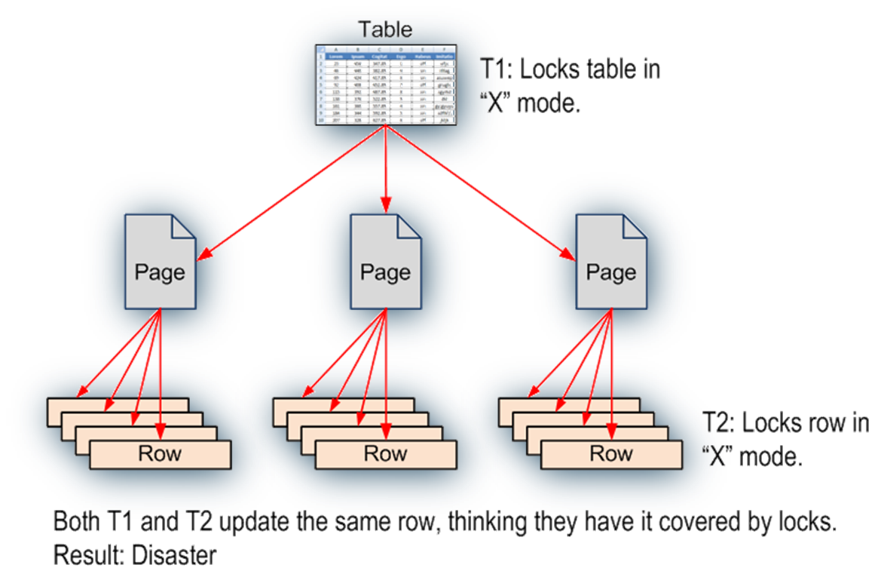
Intent Locks
Establish the lock hierarchy
In order to acquire a fine granule lock, must acquire Intent Locks on all the higher levels in the hierarchy.
Notes:
In the example shown on the slide above, if one transaction (T1) holds an exclusive lock at the table level, and another transaction (T2) holds an exclusive lock at the row level, each of the transactions believe that they have exclusive access to the resource. In this scenario, because T1 believes that it locks the entire table, it might inadvertently make changes to the same row that T2 thought it has locked exclusively. In a multigranular locking environment, there must be a way to effectively overcome this problem. The solution is intent lock.
An Intent lock is used to establish a lock hierarchy. SQL Server Database Engine acquires low-level locks and also places intent locks on the objects that contain the lower-level objects as follows:
When locking rows or index key ranges, intent lock is acquired on the pages that contain the rows or keys.
When locking pages, intent lock is acquired on the higher-level objects that contain the pages. In addition to the intent lock on the object, intent page locks are requested on the following objects:
Leaf-level pages of non-clustered indexes
Data pages of clustered indexes
Heap data pages
An intent lock indicates that SQL Server wants to acquire a shared (S) lock or an exclusive (X) lock on some of the resources lower down in the hierarchy. For example, a shared intent lock placed at the table level means that a transaction intends on placing shared (S) locks on pages or rows within that table. Setting an intent lock at the table level prevents another transaction from subsequently acquiring an exclusive (X) lock on the table containing that page. Intent locks improve performance because SQL Server examines intent locks only at the table level to determine whether a transaction can safely acquire a lock on that table. This removes the requirement to examine every row or page lock on the table to determine whether a transaction can lock the entire table.

Slide 8
Lock Mode
Lock Mode | Description
Schema-Stability (Sch-S) | Used when compiling queries
Schema Modification (Sch-M) | Used when a table data definition language operation (for example, dropping a table) is being performed
Shared (S) | Used for read operations that do not change or update data, such as a SELECT statement.
Update (U) | Used on resources that can be updated. Prevents a common form of deadlock that occurs when multiple sessions are reading, locking, and potentially updating resources later.
Exclusive (X) | Used for data-modification operations, such as INSERT, UPDATE, or DELETE. Ensures that multiple updates cannot be made to the same resource at the same time.
Intent Shared (IS) | Have or will request shared lock(s) at a finer level
Intent Update (IU) | Have or will request update lock(s) at a finer level
Intent Exclusive (IX) | Have or will request exclusive lock(s) at a finer level
Shared Intent Update (SIU) | Have shared lock with intention to acquire update lock at a finer level
Shared Intent Exclusive (SIX) | Have shared lock with intention to acquire exclusive lock at a finer level
Update Intent Exclusive (UIX) | Have update lock with intention to acquire exclusive lock at a finer level
Bulk Update (BU) | Used when bulk copying data into a table and either TABLOCK hint is specified or the table lock on bulk load table option is set
Notes:
The SQL Server Database Engine locks resources by using different lock modes that determine how the resources can be accessed by concurrent transactions. Some locks allow concurrent access to the resource, while others do not. A Shared lock, for example, is used to protect a resource that is being used for read-only access. Since the resource is only going to be read, several concurrent users can have Shared locks on the same resource. If a transaction wants to modify the data, it must first acquire an Exclusive lock. This prevents anyone from reading from or writing to the resource while the transaction is in progress. When an Exclusive lock is in place, no other locks can be granted on the resource.
Lock modes
Schema modification (Sch-M) locks are taken during a table data definition language (DDL) operation. A Sch-M lock prevents concurrent access to the table. This lock blocks all outside operations until the lock is released. You should use Sch- M locks to prevent access to affected tables by concurrent operations.
Schema stability (Sch-S) locks are taken when compiling and running queries. Sch-S locks do not block any transactional locks, including exclusive (X) locks. Transactions continue to run while a query is being compiled.
Shared (S) locks allow concurrent transactions to read (SELECT) a resource under pessimistic concurrency control. However, no other transactions can modify the data while shared (S) locks exist on the resource.
Update (U) locks prevent a common form of deadlock. Only one transaction can obtain an update (U) lock to a resource at a time. If a transaction modifies a resource, the update (U) lock is converted to an exclusive (X) lock.

Slide 9
Notes:
Exclusive (X) locks prevent access to a resource by concurrent transactions. With an exclusive (X) lock, by default, no other transactions can modify data.
Intent shared (IS) lock protects requested or acquired shared locks on some resources lower in the hierarchy.
Intent exclusive (IX) lock protects requested or acquired exclusive locks on some resources lower in the hierarchy. IX is a superset of IS, and it also protects requesting shared locks on lower-level resources.
Shared with intent exclusive (SIX) lock protects requested or acquired shared locks on all resources lower in the hierarchy and intent exclusive locks on some of the lower level resources. Concurrent IS locks at the top-level resource are allowed.
Intent update (IU) lock protects requested or acquired update locks on all resources lower in the hierarchy. IU locks are used only on page resources. If the event of an update operation, IU locks are converted to IX locks.
Shared intent update (SIU) lock is a combination of S and IU locks, as a result of acquiring these locks separately and simultaneously holding both locks.
Update intent exclusive (UIX) lock is a combination of U and IX locks, as a result of acquiring these locks separately and simultaneously holding both locks.
Bulk update (BU) locks allow multiple threads to bulk load data concurrently into the same table while preventing other processes that are not bulk loading data from accessing the table. For example, using bulk update (BU) locks when bulk copying data into a table.

Slide 10
Lock Compatibility
 | Existing granted mode
Requested mode | IS | S | U | IX | SIX | X
Intent shared (IS) | Yes | Yes | Yes | Yes | Yes | No
Shared (S) | Yes | Yes | Yes | No | No | No
Update (U) | Yes | Yes | No | No | No | No
Intent exclusive (IX) | Yes | No | No | Yes | No | No
Shared with intent exclusive (SIX) | Yes | No | No | No | No | No
Exclusive (X) | No | No | No | No | No | No
Notes:
Lock Compatibility determines whether multiple lock requests for the same resource can be granted concurrently. If a transaction requests a lock on a resource that has locks in place that are compatible with the requested lock, the lock will be granted. If the locks already in place are not compatible with the requested lock, the request will not be granted and the transaction will be blocked until the lock becomes available or the transaction times out while waiting.
An intent exclusive (IX) lock is compatible with an IX lock mode because IX means that the intention is to update only some of the rows, rather than all of them. Other transactions that attempt to read or update some of the rows are also permitted as long as they are not the same rows being updated by other transactions.
IX locks can be applied at any level of granularity above the leaf level. If a row is locked, SQL Server will apply intent locks at both the page and the table level. If a page is locked, SQL Server will apply an intent lock at the table level.
SIX locks imply that there is a shared access to a resource and that there are X locks placed at a lower level in the hierarchy. SQL Server never asks for SIX locks directly; they are always the result of a conversion. For example, suppose a transaction scanned a page by using an S lock and then subsequently decided to perform a row-level update. The row would obtain an X lock, but now the page would require an IX lock. The resultant mode on the page would be SIX.
Additional Reading:
Lock Compatibility
http://msdn.microsoft.com/en-us/library/ms186396.aspx

Slide 11
Dynamic Locking
Row locking is not always the right choice
Scanning a table with 100 million rows means 100 million calls to the lock manager
Sometimes page or table locking is the optimal way to scan
One Table lock is cheaper and easier to manage than thousands of Row locks
SQL Server chooses lock granularity (Row, Page, Table) at run time based on input from the Query Optimizer
Least-expensive method is chosen
Available resources at the time of execution may have an impact
Incorrect estimates could lead to making the wrong choice
Notes:
When modifying individual rows, SQL Server typically takes row locks to maximize concurrency (for example, OLTP and order-entry applications). When scanning larger volumes of data, it would be more appropriate to take page or table locks to minimize the cost of acquiring locks (for example, Decision Support System (DSS), data warehouse, and reporting).

Slide 12
Lock Escalation
Used to lower the number of locks taken by a transaction
Lock manager attempts to replace one transaction's many row or page locks with a single table-level lock
Escalation never converts row locks to page locks
Lock escalation happens based on Lock escalation Thresholds
Lock de-escalation never occurs
Lock Escalation behavior can be controlled
At the server level via Trace Flag 1211
At the table level via ALTER TABLE in SQL 2008 and later
AUTO
TABLE
DISABLE
Notes:
When the lock count for a transaction is a multiple of the escalation threshold, the lock manager attempts to escalate the locks. The number of locks held may continue to increase after the escalation attempt (for example, because new tables are accessed, or the previous lock escalation attempts failed due to incompatible locks held by another SPID (server process ID)).
The lock manager checks the lock memory that it is using, and if it is more than 40 percent of the allocated buffer pool memory of SQL Server, it tries to find a scan where no escalation has already been performed. The lock manager repeats this search operation until all scans have been escalated or until the memory consumption drops.
Lock escalation thresholds
Lock escalation can be triggered in any of the following situations:
When a single Transact-SQL (T-SQL) statement acquires at least 5,000 locks on a single table or index.
When the number of locks in an instance of the Database Engine exceeds memory or configuration thresholds.
If locks cannot be escalated because of lock conflicts, the Database Engine periodically triggers lock escalation at every 1,250 new locks acquired.

Slide 13
Notes:
Lock escalation behavior can be influenced via the trace flag -T1211. This disables the lock escalation for the instance. Enabling -T1211 does not prevent SQL Server from choosing page or table lock rather than row lock.
Starting with SQL Server 2008, lock escalation can also be controlled using ALTER TABLE (T-SQL Syntax).
In the ALTER TABLE (T-SQL Syntax), lock escalation can be set to specify the allowed methods of lock escalation for a table as follows:
SET ( LOCK_ESCALATION = { AUTO | TABLE | DISABLE } )
AUTO This option allows SQL Server Database Engine to select the lock escalation granularity that is appropriate for the table schema. If the table is partitioned, lock escalation will be at the Partition level. If the table is not partitioned, lock escalation will be at the Table level.
TABLE Lock escalation will be done at table-level granularity regardless whether the table is partitioned or not partitioned. This behavior is the same as in SQL Server 2005. TABLE is the default value.
DISABLE Prevents lock escalation in most cases. Table-level locks are not completely disallowed. For example, when you are scanning a table that has no clustered index under the serializable isolation level, Database Engine must take a table lock to protect data integrity
Lock: Escalation Profiler event class
Starting in SQL Server 2008, the Lock:Escalation event class was enhanced to provide additional diagnostic information. The EventSubClass column provides the reason for the lock escalation and the Type column provides the granularity details.
Additional Reading:
Lock Escalation
http://msdn.microsoft.com/en-us/library/ms184286.aspx
Lock:Escalation Event Class http://msdn.microsoft.com/en-us/library/ms190723.aspx

Slide 14
Locking Hints
Can be specified using the SELECT, INSERT, UPDATE, and DELETE statements
Direct SQL Server to the type of locks to be used
Granularity hints: ROWLOCK, PAGLOCK,TABLOCK
Isolation LEVEL hints: HOLDLOCK, NOLOCK
READCOMMITTED, REPEATABLEREAD, SERIALIZABLE, READUNCOMMITTED, READCOMMITTEDLOCK
UPDLOCK: Use update lock rather than shared lock when reading
XLOCK: Use exclusive lock instead
READPAST: Will “skip” rows that are currently locked
Used when a finer control of the types of locks acquired on an object is required
Override the current transaction-isolation level for the session
Notes:
Locking hints specify the type of locking or row versioning that the instance of the Microsoft SQL Server Database Engine uses for the table data. These locking hints override the current transaction isolation level for the session.
You can specify locking hints for individual table references in the SELECT, INSERT, UPDATE, and DELETE statements.
Hints take away SQL Server’s ability to adjust its behavior based on changing conditions on the server and thus should be used sparingly and only when absolutely necessary. Queries that use hints should be monitored closely and tested periodically to verify that the hint is still required and is behaving as intended.
Additional Reading:
Table Hints http://msdn.microsoft.com/en-us/library/ms187373.aspx

Slide 15
Lesson Review
Why is an intent lock acquired?
What is lock escalation and can it be controlled?
What are locking hints?
Notes:
Why is an intent lock acquired?
ANSWER: An intent locks is used to establish a lock hierarchy. It indicates that SQL Server wants to acquire an S or X lock on some of the resources lower down in the hierarchy.
What is lock escalation and can it be controlled?
ANSWER: SQL Server’s lock manager automatically tries to escalate a lock when the lock count for a transaction is a multiple of the escalation threshold. Since SQL Server 2008, lock escalation can be controlled using ALTER TABLE command.
What are locking hints?
ANSWER: Locking hints can be used to override the default locking behavior of the current transaction.

